Slide 1
History of Programming Languages
Paul Kim

Slide 2
Looking at history…
Fun activity
Process of seeing how things were in past and how they have been evolved
In this slide, we will look at…
How programming languages were in the past
How programming languages have been evolved

Slide 3
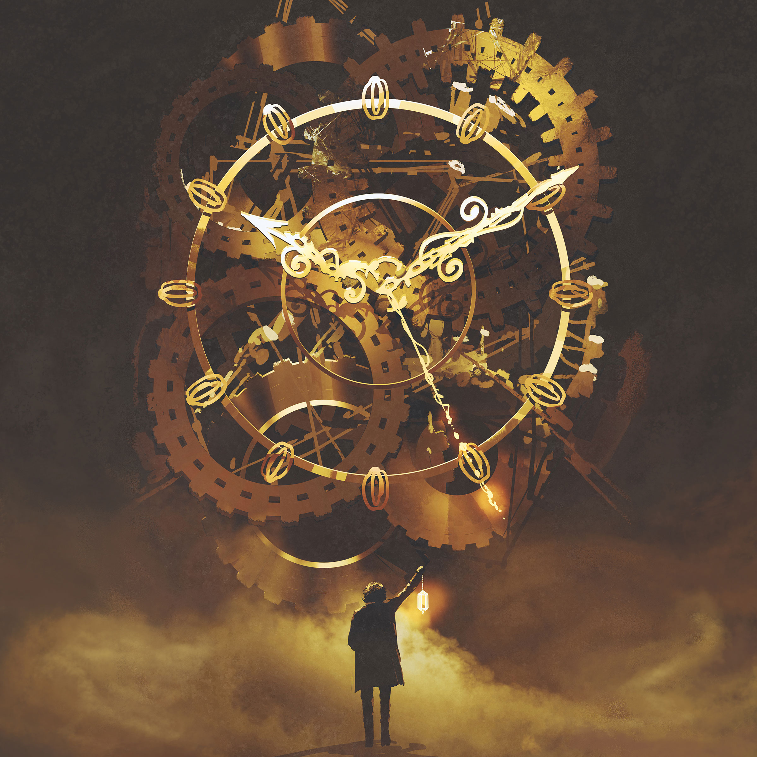
Programming Languages
Almost 70 years of history (since 1940s…)
Currently, around 700 programming languages
Now, let’s start the time travel!
https://sloanreview.mit.edu/article/imaginary-time-travel-as-a-leadership-tool/

Slide 4
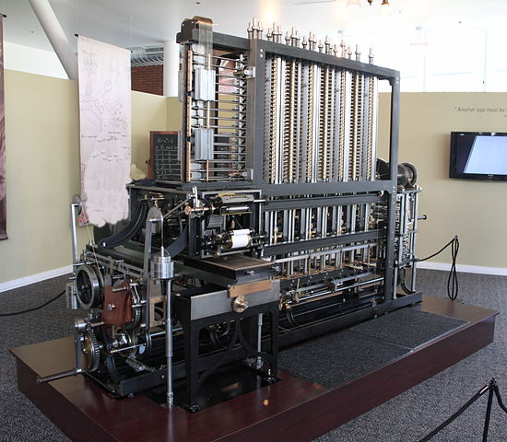
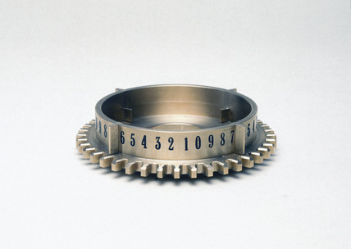
Gears with digits (Difference Engine)
To give instructions,
Changing Gears
https://www.youtube.com/watch?v=XSkGY6LchJs
1820
By Canticle at English Wikipedia, CC BY-SA 3.0, https://commons.wikimedia.org/w/index.php?curid=10532728
https://www.ssplprints.com/image/90422/figure-wheel-of-babbages-difference-engine-no-2-1991

Slide 5
Binary Code in electronic computer
Electronic Computer understands 0s and 1s
Code with 0s and 1s
1945
By User:Atyndall (See account on English Wikipedia) - Own work, CC BY-SA 3.0, https://commons.wikimedia.org/w/index.php?curid=3904637
Notes:
Old electronic, digital computer

Slide 6
Binary Code
ENIAC (Electronic Numerical Integrator and Computer)
To give instructions,
Wiring Cables
Entering 0 and 1 physically
1945
Notes:
Old electronic, digital computer

Slide 7
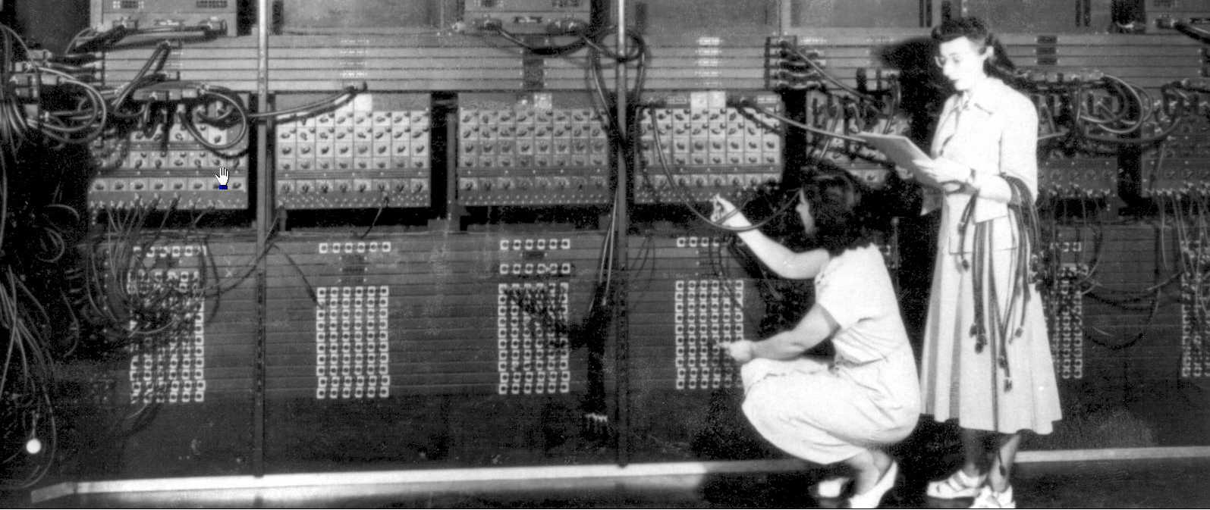
Binary Code
ENIAC (Electronic Numerical Integrator and Computer)
To give instructions,
Wiring Cables
Entering 0 and 1 physically
Usually took two weeks to program
1945
Two early programmers (Gloria Ruth Gordon [Bolotsky] and Esther Gerston) at work on the ENIAC. US Army photo from the archives of the ARL Library (US Army Research Laboratory).
Notes:
Old electronic, digital computer

Slide 8
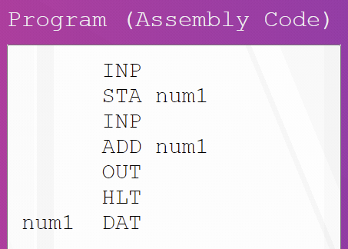
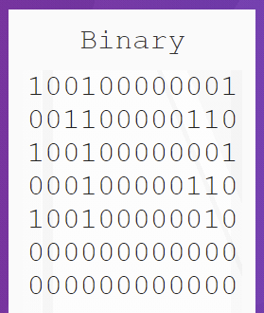
Assembly Language
To give instructions,
Use words (mnemonics) instead of 0 and 1
Assembler: words → 0 and 1
1949
https://www.101computing.net/assembly-language/

Slide 9
Assembly Language
Machine Dependent
Different computer architecture → different assembly language
Need to understand computer architecture
1949

Slide 10
FLOW-MATIC
Developed by Grace Hopper
Business data processing language
To give instructions,
Use English-like statements
1955

Slide 11
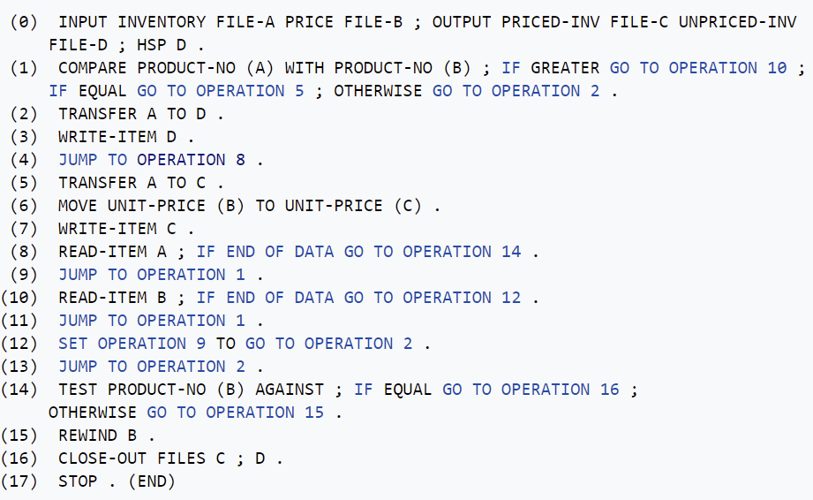
FLOW-MATIC
Comes with compiler
English-like code → Assembly code
1955
FLOW-MATIC example (https://en.wikipedia.org/wiki/FLOW-MATIC)

Slide 12
Fortran
Developed by John Backus at IBM
First-widespread compiled language
Basic Data Types (integer, real, double, T/F)
Used for scientific computations
1957

Slide 13
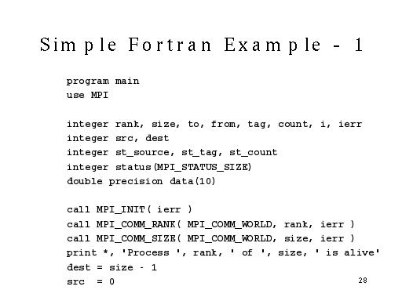
1957
https://www.macs.hw.ac.uk/~hwloidl/docs/MPIIntro/img27.html

Slide 14
LISP
Designed by John McCarthy at MIT
First functional programming language
Pioneered many ideas in computer science
If-then-else, Tree data structure, Recursion…
read-eval-print loop (Interactive Programming)
1958

Slide 15
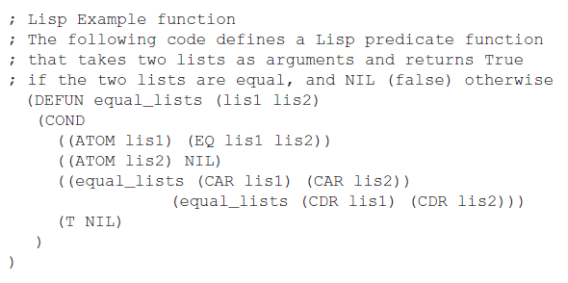
1958
https://www.chegg.com/homework-help/questions-and-answers/lisp-programming-language-question-suppose-equallists-function-called-lists-b-c-d-e-b-c-d--q29894771

Slide 16
Algol
ALGOrithmic Language
Structured Programming
Code blocks with ‘Begin’ and ‘End’ pair
Influenced Pascal, C, C++…
1958

Slide 17
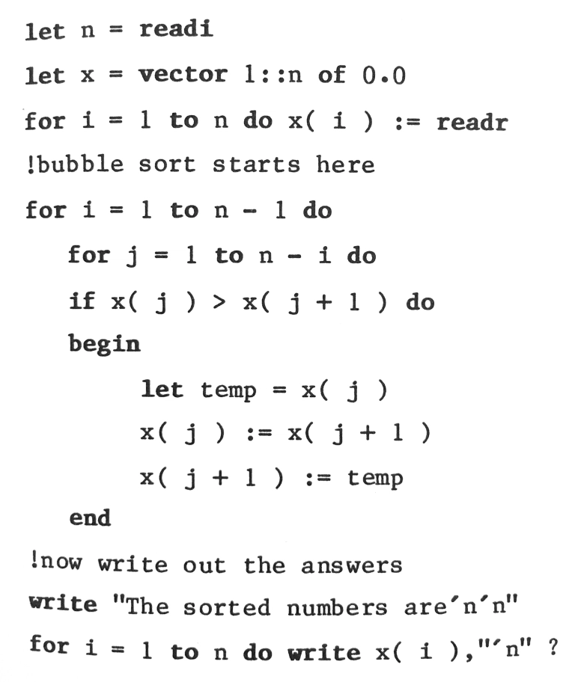
Standard language to describe algorithm in 1980s and 1990s
1958
https://craftofcoding.wordpress.com/category/algol/

Slide 18
COBOL
Developed by a consortium of the US government and businesses
Business-oriented computer language
Based on FLOW-MATIC
1959

Slide 19
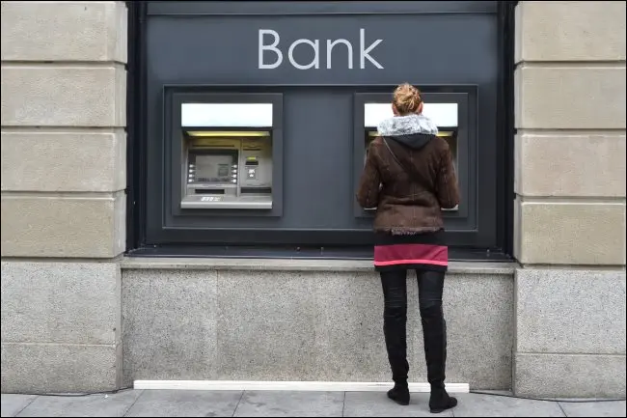
COBOL
Still used in bank and insurance company
1959
https://www.howtogeek.com/667596/what-is-cobol-and-why-do-so-many-institutions-rely-on-it/

Slide 20
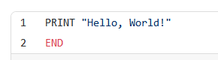
Basic
Developed by John G. Kemeny and Thomas E. Kurtz at Dartmouth College
Beginner's All-purpose Symbolic Instruction Code
Educational language for non-science students
Ancestor of Visual Basic
1964
https://medium.com/javarevisited/70-years-of-hello-world-with-50-programming-languages-2400de893a97
Notes:
encourage

Slide 21
Pascal
Developed by Niklaus Wirth
Educational language to teach good programming practices
Combined best features of well-known languages like Fortran, COBOL, Algol
Added CASE statement
Very successful in 1970s
1968

Slide 22
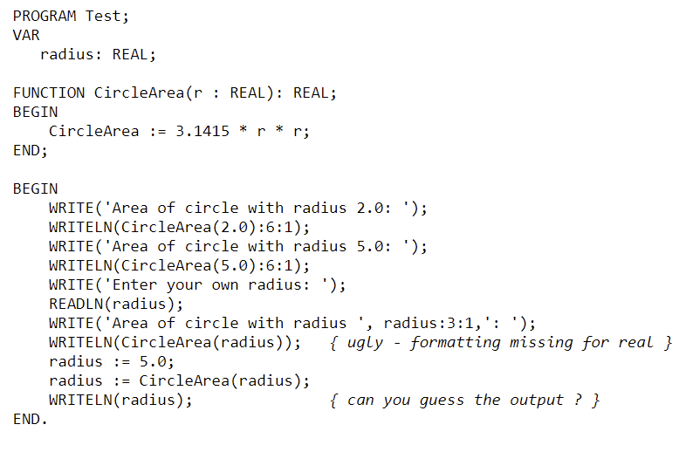
Pascal
Based on Algol pattern but with complex data types like list and tree
1968
http://pirate.shu.edu/~wachsmut/Teaching/CSAS1111/Notes-Pascal/pascal1.html

Slide 23
C
Developed by Dennis Ritchie at Bell Labs
Used to rewrite UNIX
Fast performance like Assembly
Detailed control over memory
Easy programming unlike Assembly
Concise syntax (at that time)
(ex. Begin … End → { … } )
Still one of most popular languages
1972

Slide 24
1972
Smalltalk
1972
Prolog
Logic Programming
1973
ML
Functional Programming
1975
Scheme

Slide 25


As project scale became complicated,
people began to think how to increase productivity in programming
→ How to manage big program efficiently

Slide 26
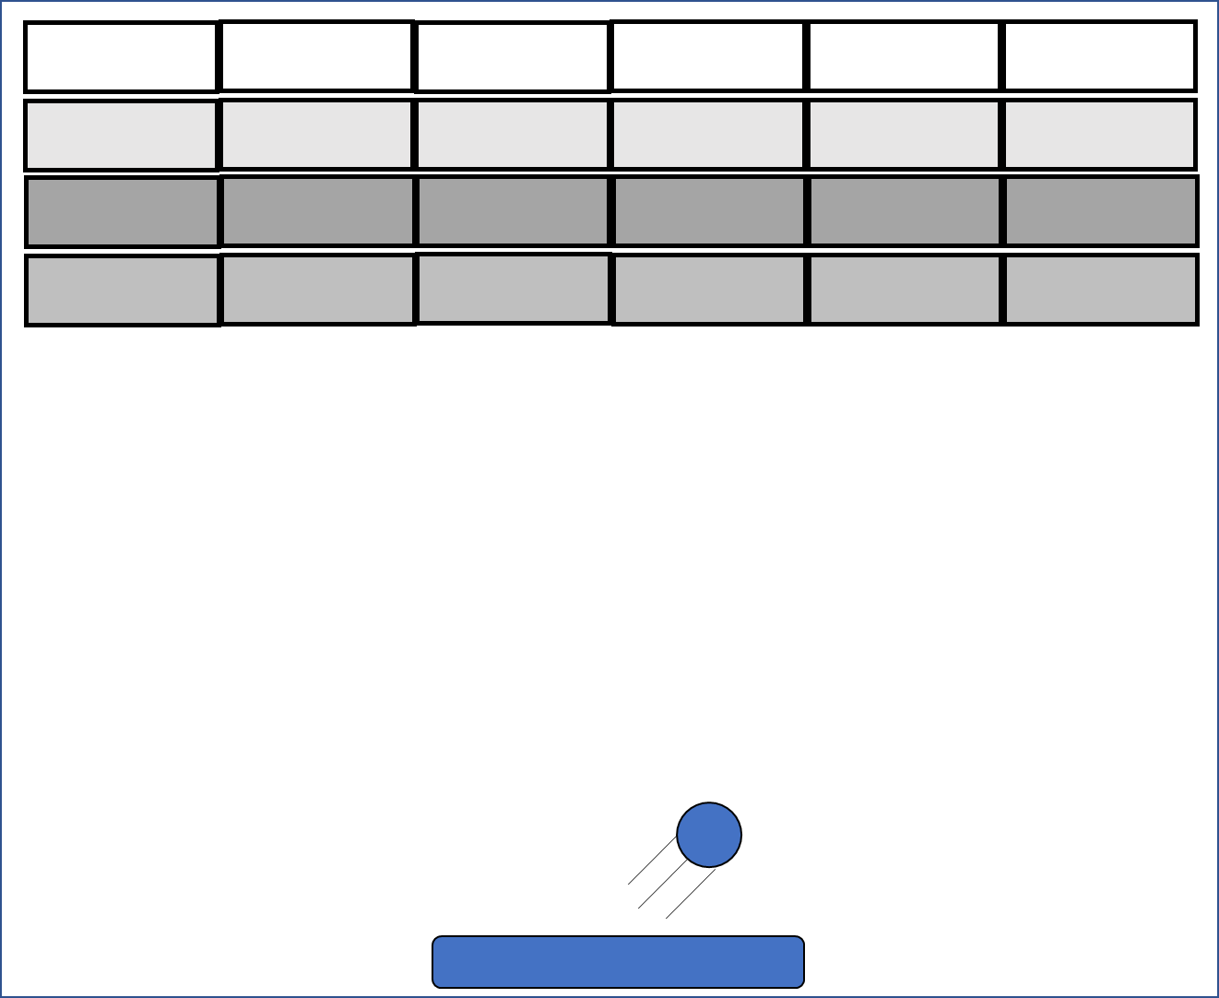
Object-Oriented Programming
Manage program in terms of object
int box1x;
int box1y;
int box2x;
int ballx;
int bally;
break(box1x, box1y, ballx, bally);
. . .
. . .
Without Object-Oriented Programming
Source code
When error happens in ball, need to look at all part of code

Slide 27
Object-Oriented Programming
Manage program in terms of object
class Box {
int x;
int y;
}
class Ball {
int x;
int y;
}
x
y
x
y
Box box1 = new Box();
Box box2 = new Box();
Ball ball = new Ball();
break(box1, ball);
x
y
With Object-Oriented Programming
Source code
When error happens in ball, just need to look at ball object

Slide 28
Object-Oriented Programming
Manage program in terms of object
Easy to handle errors
Code reuse
Easy extension to existing program

Slide 29
C++ (C with Classes)
Developed by Bjarne Stroustrup
Extended C with object-oriented programming
Still very widely used
1983

Slide 30
1983
Ada
1984
MATLAB
1985
Eiffel
1986
Objective-C

Slide 31
1986
LabVIEW
1986
Erlang
1987
Perl
1990
Haskell

Slide 32
Python
Developed by Guido van Rossum
Started implementation as a hobby during the Christmas week in 1989
Simple syntax, Fast implementation speed, Various applications
Taught in COMP 151
1991

Slide 33
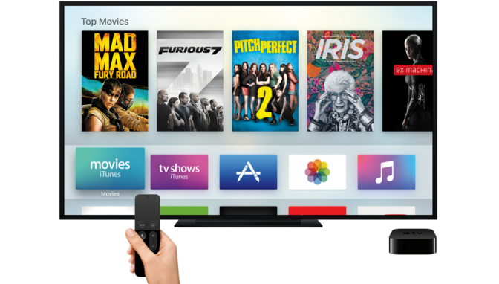
Java
Developed by James Gosling at SUN
intended to run on interactive TV
Making program runs on many types of machine
Failed because of hardware limitation at that time
1994
https://www.business2community.com/tech-gadgets/apple-finally-makes-interactive-tv-a-reality-01376244

Slide 34
Java
After interactive TV failed, Java’s focus was changed to web
As web became popular, Java became popular
Taught in COMP 152
1994

Slide 35
1995
Ruby
1995
Delphi
1995
JavaScript
1995
PHP
1997
Rebol
2000
ActionScript
2001
C#

Slide 36
2002
Scratch
2003
Groovy
2003
Scala
2005
F#
2006
PowerShell
2007
Clojure
2008
Nim
2009
Go

Slide 37
2010
Rust
2011
Dart
2011
Kotlin
2011
Elixir
2012
Julia
2012
TypeScript
2014
Swift

Slide 38
Now it’s your turn!
Continued

